Slide 1
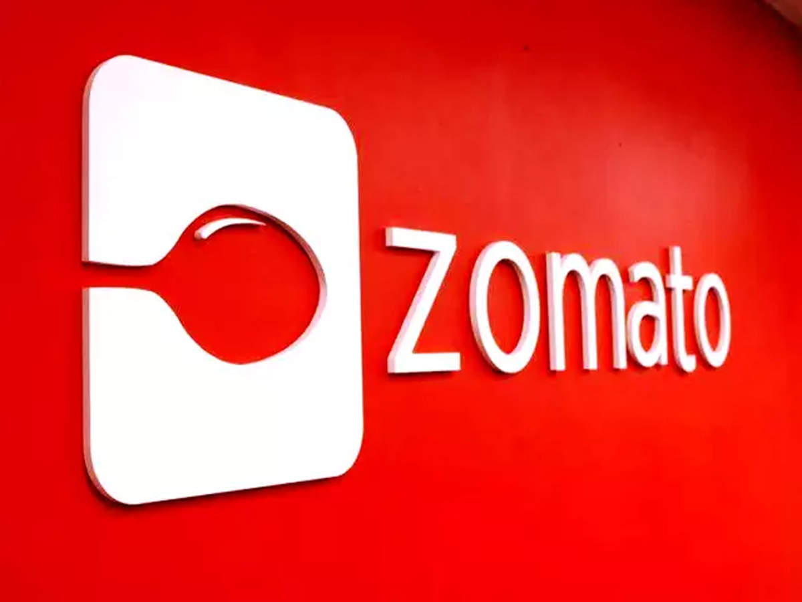

Slide 2

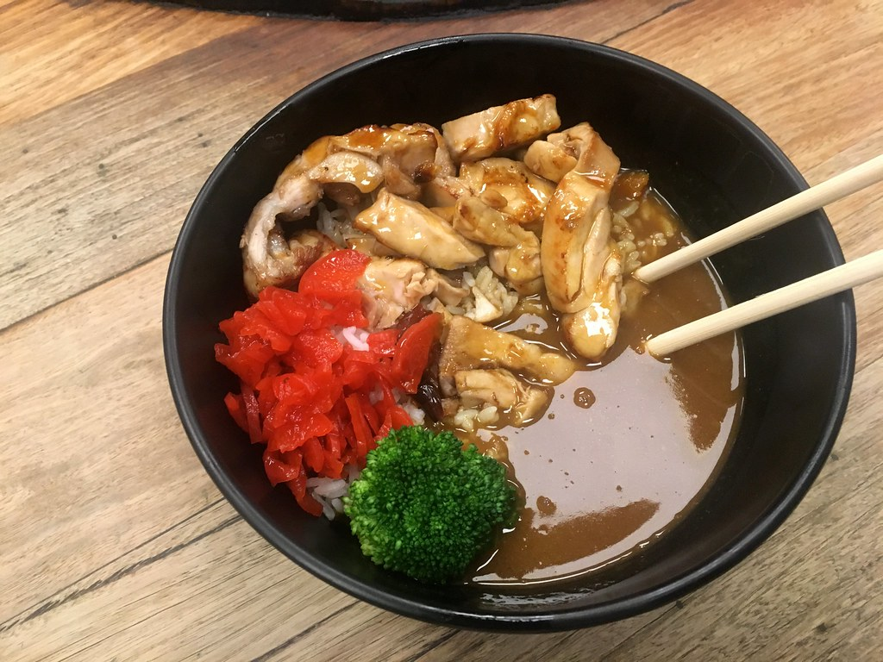
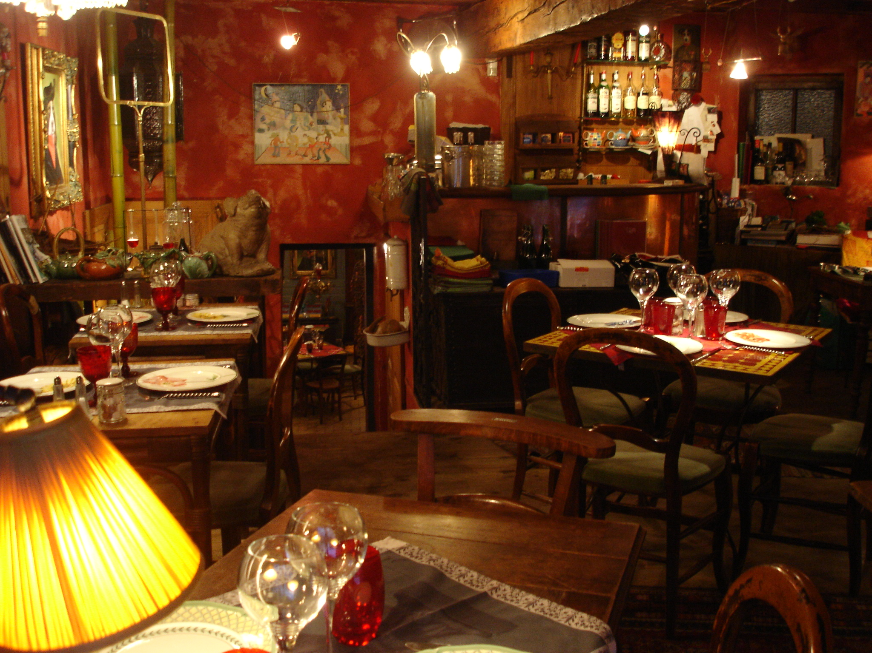
A Presentation on
Zomato
Restaurants Analysis

Slide 3

Submitted by- Group 3
Akshay Sarkate
Vaishnavi Ambhore
Sagar Desai
Ujjwala N

Slide 4

Introduction
The Zomato Restaurants Analysis project aims to thoroughly analyze restaurant data from Zomato, a popular platform for finding and reviewing restaurants. This report gives a clear and detailed look at the project's goals, the methods used, the findings from the analysis, the implications of these findings, and the conclusions drawn. We will explore how the data was collected and processed, what the analysis revealed about restaurant trends and performance, and what these results mean for understanding the restaurant industry better.

Slide 5
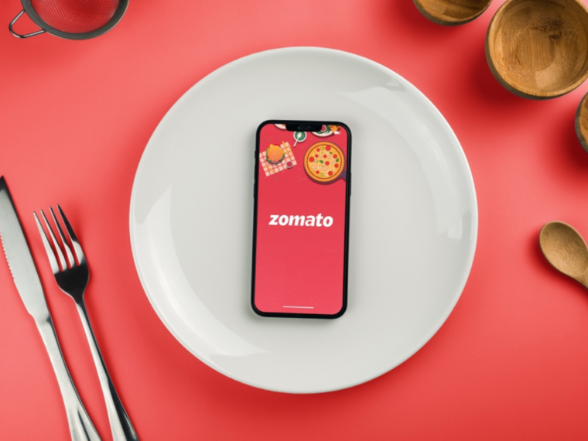
About Zomato
Zomato is a leading online platform that helps users discover and review restaurants. It provides detailed information about restaurants, including menus, photos, and user reviews. Zomato's extensive database and user-generated content make it a valuable resource for both diners and restaurant owners.

Slide 6
Overview
This project involves a comprehensive analysis of Zomato restaurant data using advanced Excel functions, SQL queries, and interactive dashboards created with Power BI and Tableau.
The primary objective is to extract valuable insights into restaurant industry trends related to location, opening trends, ratings, and price ranges

Slide 7
Objectives
Develop various charts that show data based on cuisines, city, and ratings.
Construct a Calendar Table using the Datekey column.
Create a comprehensive Country Map Table.
Compute the number of restaurants based on average ratings.
Calculate the number of restaurants opening by year, quarter, and month.
Determine the number of restaurants in each city and country.
Generate price buckets based on average prices and count the restaurants in each bucket.
Calculate the percentage of restaurants that offer table bookings.
Determine the percentage of restaurants that provide online delivery.

Slide 8
Methodology
The approach includes:
Extracting and cleaning data with Excel and SQL.
Analyzing data using advanced Excel functions and SQL queries.
Creating interactive dashboards and visualizations with Power BI and Tableau.

Slide 9

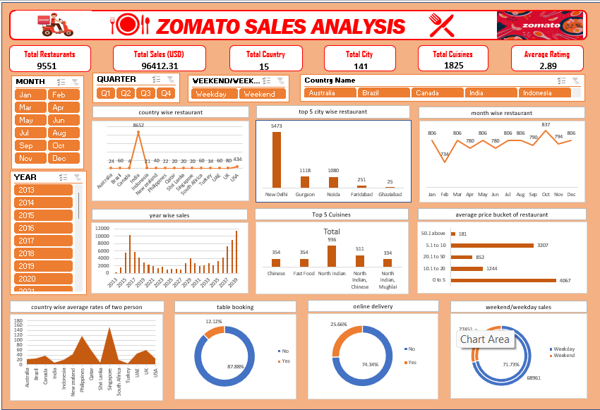
Excel Analysis
Used advanced Excel functions to clean, manage, and visualize data.
Created charts and graphs to show restaurant data by location, ratings, price range, and cuisine.
Analyzed data to find trends and patterns.

Slide 10

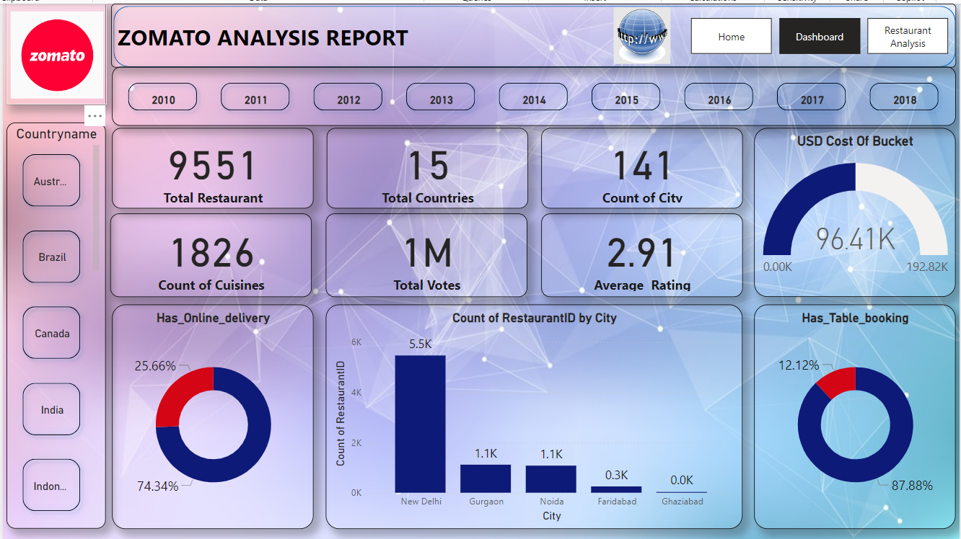
PowerBi Analysis
Made interactive dashboards in Power BI to show and analyze Zomato restaurant data.
Created visuals to explore trends in location, ratings, price range, and cuisine.
Added slicers, filters, and drill-down features for easy data exploration.

Slide 11

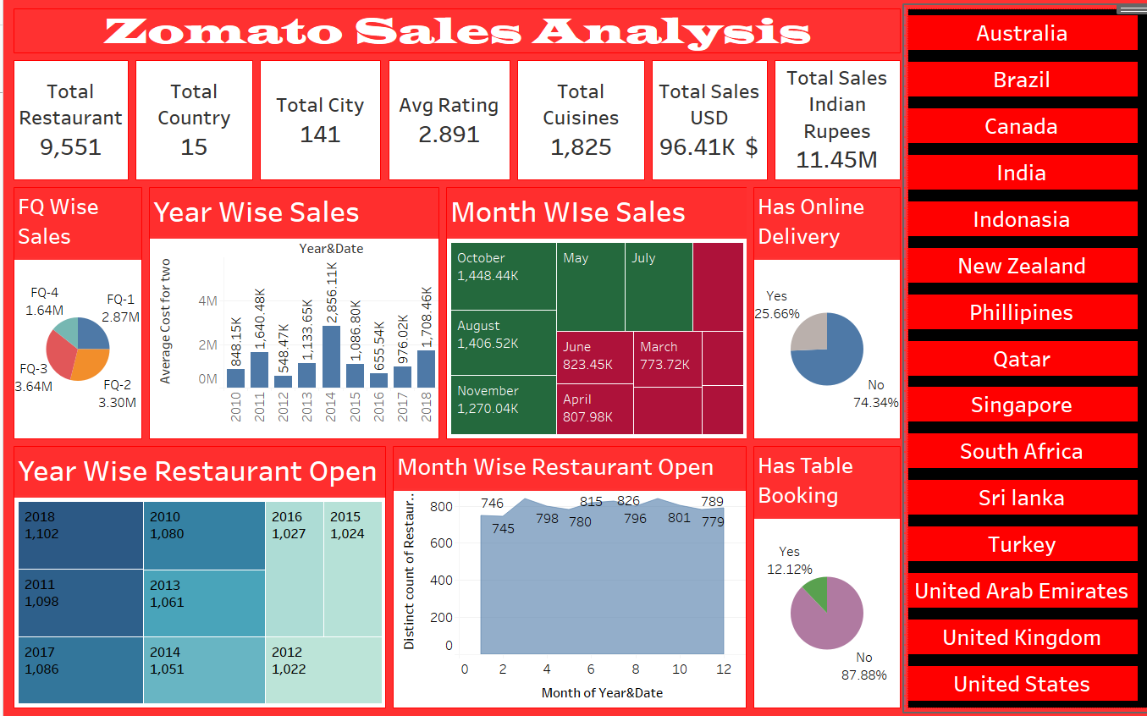
Tableau Analysis
Used Tableau to create visuals and analyze Zomato restaurant data.
Made interactive dashboards to show trends in cuisine, city, ratings, and price range.

Slide 12

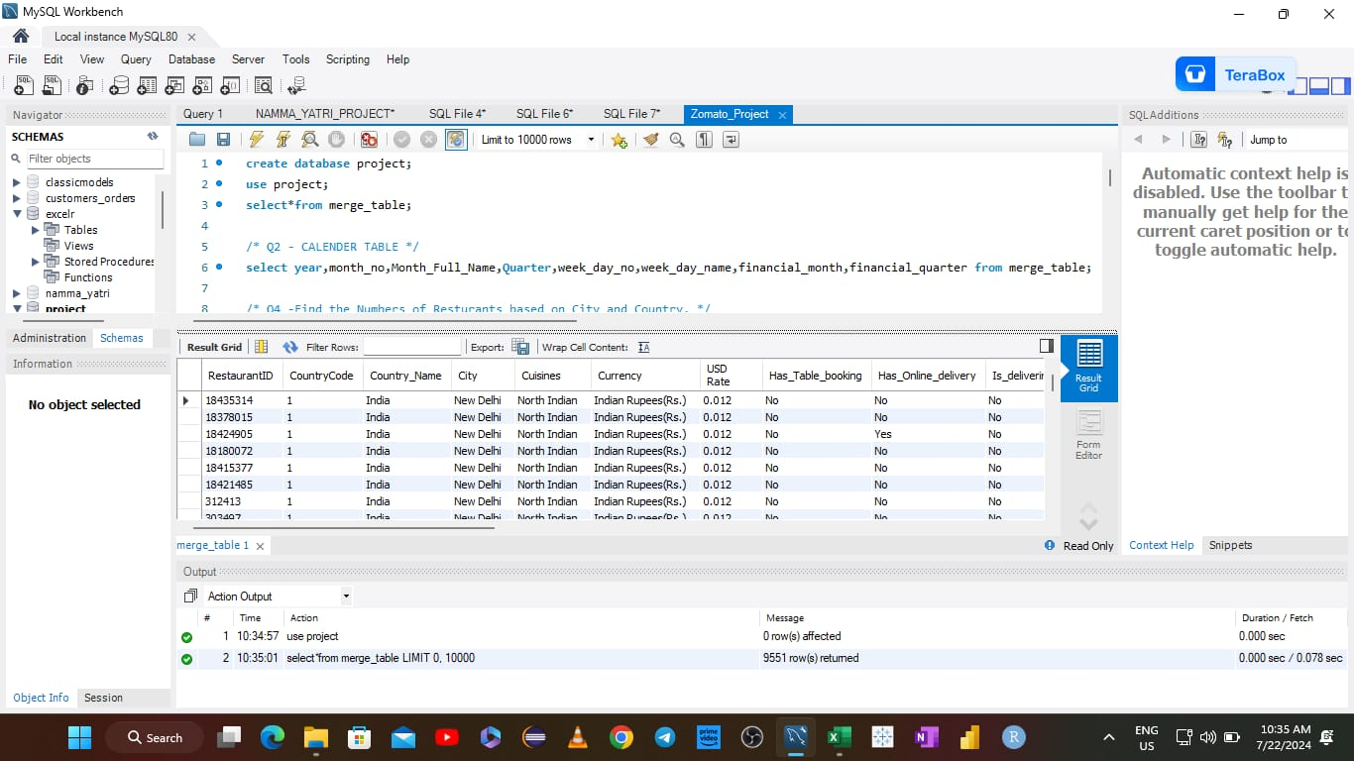
SQL Queries
Ran SQL queries to get and work with data from the database.
Measured things like the number of restaurants in each city, trends in openings, average ratings, and average prices.
Combined data from different tables using SQL joins and subqueries for better analysis.

Slide 13
Conclusion
The Zomato Restaurants Analysis project offers important insights into the restaurant industry. Using advanced analytics and visualization tools, we've gathered information that can help make better decisions and strategies in the industry. The detailed analysis and visuals in this report provide a clear understanding of restaurant trends and customer preferences, supporting data-driven decision-making in the restaurant business.

Slide 14
Suggestions
Consider increasing the number of restaurants listed in the most populated areas to better meet demand and attract more users.
Improve the user interface to make it easier for users to find and review restaurants, focusing on the most popular and highly rated options.
Highlight and promote restaurants with high ratings and positive reviews to attract more users and encourage repeat visits.
Continue to gather detailed data on customer preferences and dining trends to provide more personalized recommendations and insights.
Identify and promote trending cuisines and popular dining locations to attract a larger audience and increase user engagement.
Improve the filtering and search capabilities for different price ranges to cater to diverse customer budgets and preferences.

Slide 15
Thank
You

